Slide 1
Introduction to Web Technologies
All not covered in the previous 5 slides
Lecturer: Christen Cao

Slide 2
Content
17 Tested Elements
3 Exercises

Slide 3
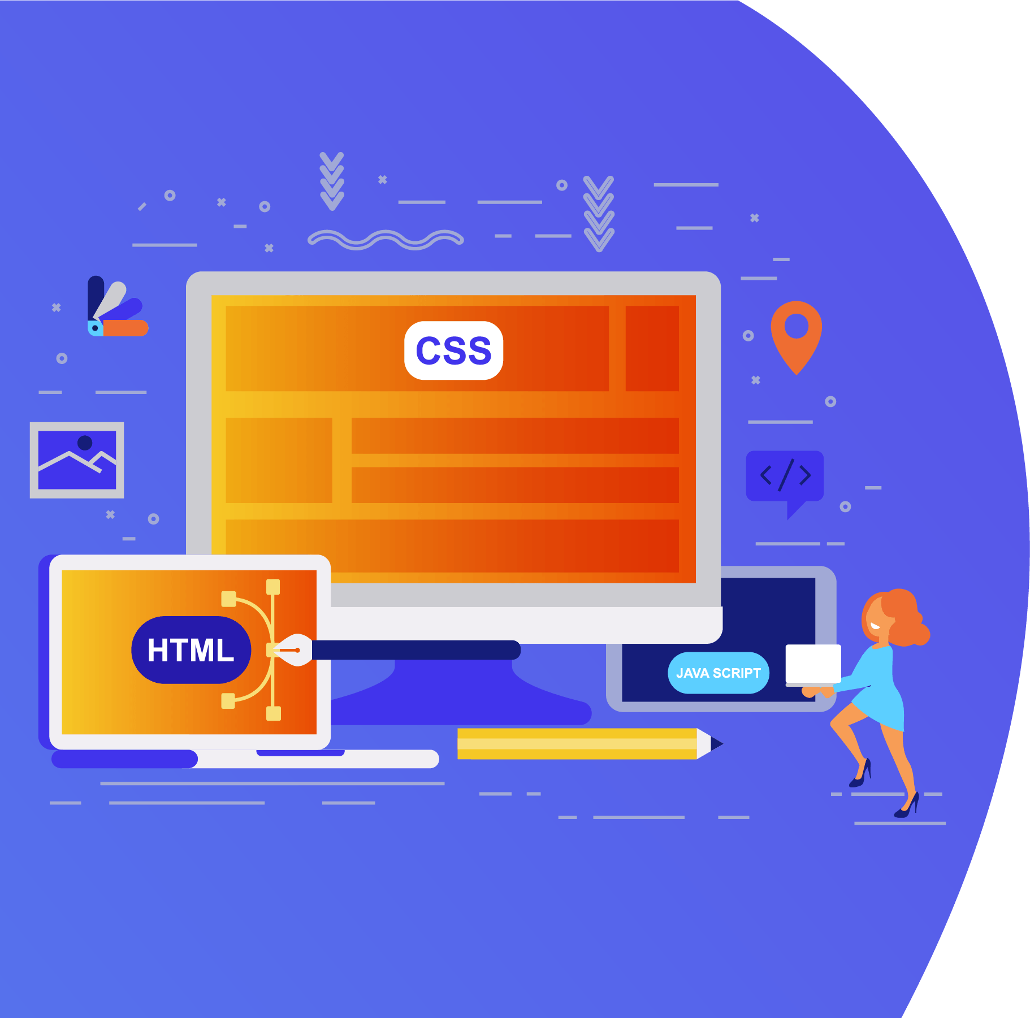
Topic 1: 17 Tested Elements

Slide 4
Basic HTML Tags
HTML is a fairly straightforward programming language. Each tag starts with a “<“ and ends with a “>”
For example the paragraph tag is <p>
There is a range of HTML tags, they help you to design your web page. There are four required tags in HTML. These are html, title, head and body. The table below shows you the opening and closing tag, a description and an example.
Notes:
https://www.cs.kent.ac.uk/teaching/10/modules/CO/3/32/FIT_Chapters/Chapter04/BasicHTMLTags.html

Slide 5
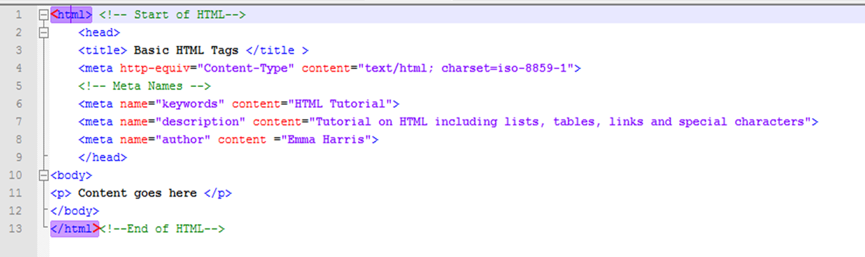
<html></html>
Start HTML Tag | End HTML Tag | Description
<html> | </html> | These are the tags you put at the beginning and end of an HTML file.
Example

Slide 6
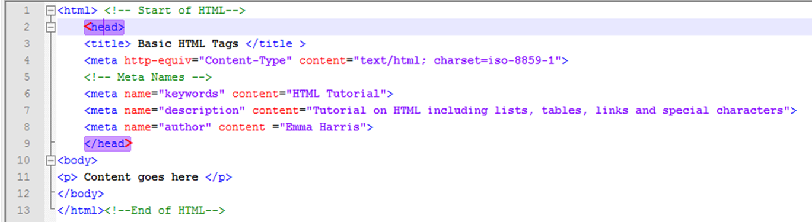
<head></head>
Start HTML Tag | End HTML Tag | Description
<head> | </head> | This includes information including title, meta tags, content type, links to external pages like CSS and JavaScript.
Example

Slide 7
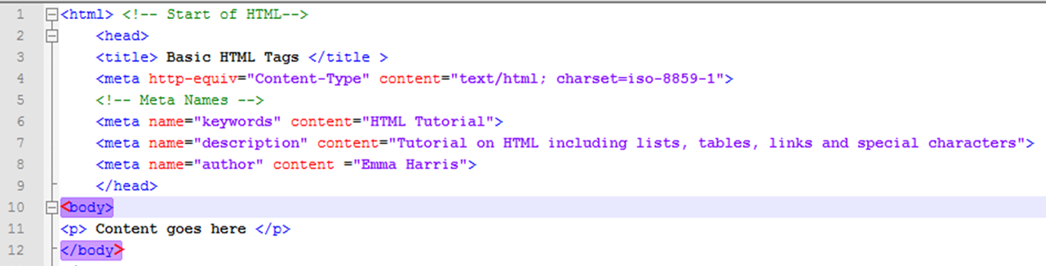
<body></body>
Start HTML Tag | End HTML Tag | Description
<body> | </body> | This contains the contents of the document
Example

Slide 8
<p>, <h1>, <h2>, … <h6>
Open tag | Close tag | Description | Example
<p> | </p> | This tag allows you to create paragraphs | My name is Fred. I live in Medway
<h1> | </h1> | This is the largest heading | Heading 1
<h2> | </h2> | This is second biggest heading | Heading 2
<h3> | </h3> | This is the next heading | Heading 3
<h4> | </h4> | This is another heading | Heading 4
<h5> | </h5> | This is the second smallest heading | Heading 5
<h6> | </h6> | This is the smallest heading | Heading 6

Slide 9
HTML Exercise

Slide 10
CSS Exercise

Slide 11
JavaScript Exercise

